Slide 1
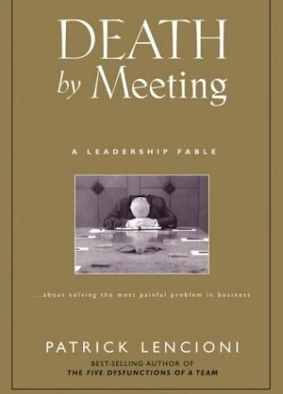
Patrick Lencioni – Death By Meetings
It is not about less meetings, it is about having different meetings for different purposes and ensuring all are interesting, engaging and encourage critical debate.
Make meetings better than TV and Films!

Slide 2
Avoid a ‘meeting default’ response
To move forward, do I really need a real time conversation?
Does this necessitate a face-to-face conversation?
Schedule and prepare for a meeting
Have I thought through this situation?
Do I need outside input to make progress?
No
No
No
No
Schedule a time for strategic thinking
Schedule a time for doing the work
Use chat, call or schedule a video conference
Send an email

Slide 3
Common problem | Possible approach?
Excessive ratio of informing to using the information | Put informational and noncontroversial items in a consent agenda, circulated in advance; do not discuss unless someone specifically requests For each agenda item, indicate status (information, action, vote etc.)
Lack of advance thinking on critical issues Average advance thinking on the circulated agenda is < 1.5 minutes | Give people active and differentiated assignments publicly, in advance, Indicate on agenda the name of the person expected to start each piece of the discussion
Defensive participation (people come to prevent bad things rather than to advance the agenda) | Begin key discussion with a few moments of silence so everyone can collect their thoughts Charge people with coming to the meeting with some ideas to kick off the discussion Explicitly invite people to think on both sides of a controversy (use De Bono's hats, for example
Disruptive members | Make sure that all meeting participants understand their responsibilities. Consider breaking larger group into smaller groups to develop input If people are vocally dominant redirect discussion to other members: "We all recognise your expertise in this area, but let’s hear from some others in case some new ideas emerge.“ “Does anyone else have something they would like to add?“ If people are negative, probe the negativity to validate concerns, redirect discussion to other members, if behaviour persists, consider speaking off-line
Nothing that we agree to do in the meeting ever “gets done” | Get people to playback what they understand they need to do at the end of the meeting Promptly prepare and distribute minutes with highlighted action items, clearly tasked (who, what, and by when) Monitor activities, progress and issue reminders – hold people to account Re-assign incomplete tasks to “doers”

Slide 4
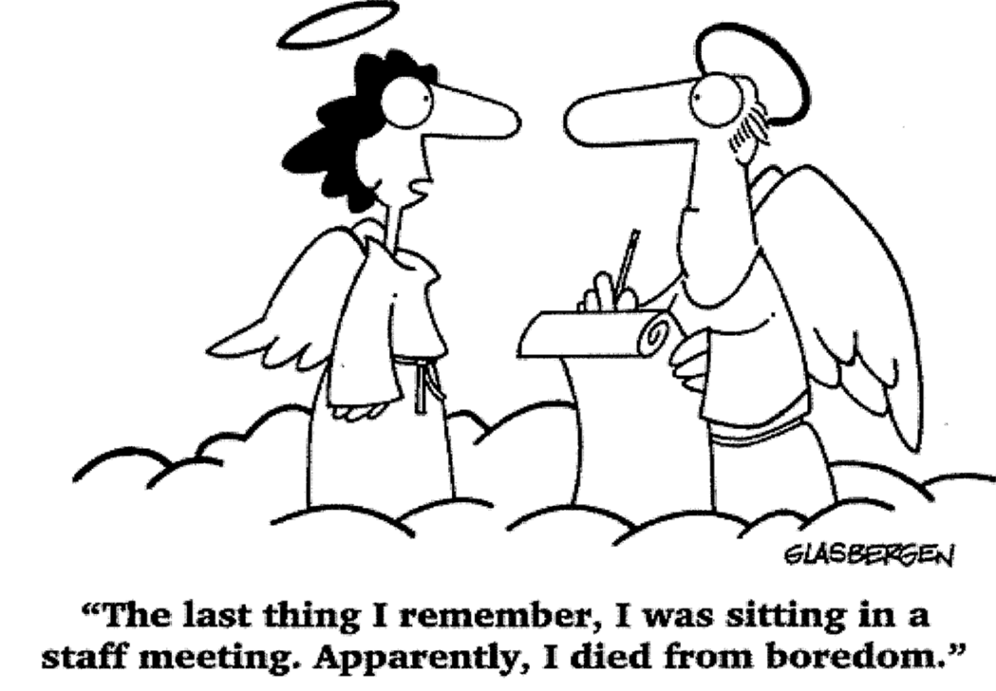
Meeting structures

Slide 5
Four meeting approach as a possible option
Operational Team Catch Up – Daily 5 minutes
Tactical – Weekly 30 to 60 minutes
Strategic – Typically Monthly, 2 to 3 hours minimum, often longer
Quarterly (or Bi-Annually) Review Off-site – one day minimum

Slide 6
Operational Team Catch Up
Daily, 5-10 minutes (immediate term - what we need to deal with in the next 24 to 48 hours)
Standing up (the huddle) if on site so people make it meaningful but swift.
What are each of us doing today:
Focused on avoiding things falling through the cracks
Note duplicate / step on each other’s toes
Alleviating need for emails about scheduling, daily tasks and priorities

Slide 7
Tactical Weekly Team Meeting
Weekly for 30 – 60 minutes
Tactical issues e.g. short-term plans, threats and risks, and opportunities - what’s happening, critical this week, key metrics and areas of particular concern
Important to avoid temptation to go into strategic issues as not enough time to debate them properly.
Stick to solving short-term problems rather than strategic ones

Slide 8
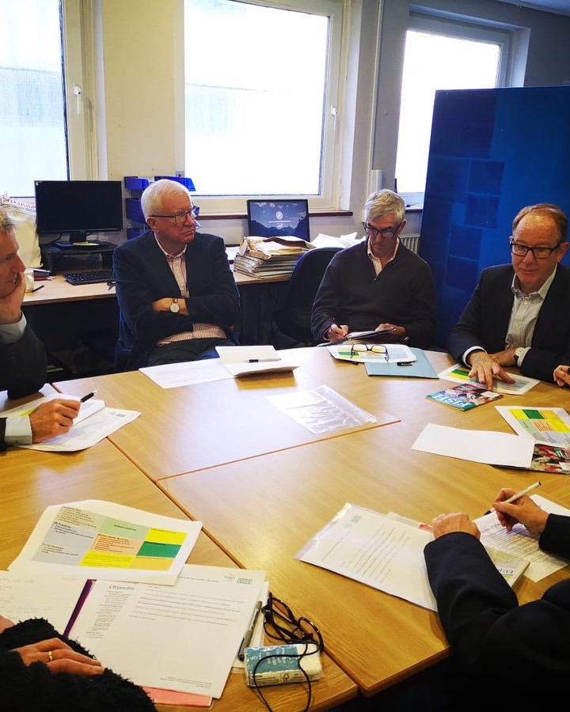
Tactical Team Meeting – Example Structure
Lightening Report - 1 minute report (headlines not detail) on what each person is doing in the week ahead based on priorities, issues, concerns and needs
Progress Review - critical metrics (five or six maximum) (no more than 15 minutes total)
Real Time Agenda - spontaneous agenda based on what’s evolved as key / critical at the start of this meeting (not prefixed before)
Let's the real issues come to the table (not prefixed)
Tactical issues that should ensure the short term objectives are not in jeopardy.
Chance for resolution of issues and reinforcement of clarity. Ensure all are on the same page.

Slide 9
Strategic Meeting
Monthly, 2-3 hours minimum (longer if necessary)
One to three (strategic) agenda items maximum.
Identify and talk about the critical issues that will effect the organisation in fundamental way.
Chance to dive into a topic without distraction of deadlines and tactical concerns.
Ad hoc Strategic Meetings - Strategic issues that have surfaced in tactical meetings and can’t wait for scheduled Strategic Meeting.

Slide 10
Quarterly or Bi-Annually Off-Site
Chance to take a step back and review carefully what’s happening
Futures, scenarios, strategic issues that need more time than monthly meetings. For example:
Comprehensive Strategic Review - What’s changed and what does it mean strategically.
Team Review - How we interact as a peer group, our behaviours and values.
Peer Review - chance to review key personnel, how we will retain top performers and work consistently with poor ones.
Service or Quality Review - What’s happening around us (externally). How is our service changing? What are others doing?
Avoid overburdening with tightly timed timescales and ,formal presentations and keep it to ‘the team’ and you want to fully participate, one trusted unbiased facilitator (external).

Slide 11
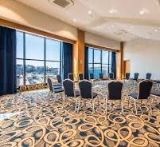
Section 4 – Practicalities: Get The Setting Right, Online Meetings and Common Problems

Slide 12
Meeting room arrangements
Discuss the merits and negatives of each one:
Theatre Style
U-Shaped Style
Circle Style
X
X

Slide 13
Meeting Room Arrangements
X
Theatre Style
Leader has great power by position.
Participation and interruption by audience is limited.
U-Shaped Style
Equality of membership.
No doubt of who the leader is.
Good visibility for visual aids.
Circle Style
Democratic: equality is stressed.
Great visibility by participants.
Obvious body language.
Excellent participation.
X

Slide 14
Online Meetings
Your experience to date and lessons learned:
What are the key challenges when chairing
What are the do’s and don'ts that you have noted?
What do you think works well – would do more of?

Slide 15
On-line meeting: preparation
Be clear on the context and purpose (and whether any research, consideration, etc. needed)
Be clear who will attend
Choose time carefully
Design the meeting with a common visual focus (e.g. slides, whiteboard etc.)
Plan the meeting with specific opportunities to engage all attendees
Send out and relevant material ahead of time
Make technical arrangements well in advance
Have a back-up plan

Slide 16
Online meetings and etiquette
Early log-in to ensure technology is working
Limit background noise
Identify everyone on the call
Avoid multi-tasking – if you notice it is happening, pause and ask for reflection
Be polite – intent v impact
Make people aware how to make presence known and how to flag wish to participate

Slide 17
Tips for on-line facilitators/chairs
People take in most information visually
For meetings online the chair or facilitator must make an extra effort to help people connect, concentrate and feel part of the team:
Allow time for introductions and small talk to help build relationships.
Address participants by name – helps to keep virtual participants engaged and away from multi-tasking.
Provide commentary on what you're noticing (e.g. “Michael looks like he really didn’t like that suggestion. Michael, please share your thoughts.”).
Think about whether you want to schedule an 'activity' during the break
Look for creative ways to make virtual attendees feel comfortable in their environment – e.g share pictures of where they are if happy to do so.

Slide 18
Section 5 –Endings are important

Slide 19
Ending the meeting
Spend 5-10 minutes in total with every owner summarising key tasks and decisions for the day
Review how the meeting went/invite reflections
End on time and on a high
Shows respect for attendees
Nobody ever complains about ending on time
Invite a volunteer to fill in absent members so they will be up to speed, and also feel their absence was noted and their presence/ thinking is valued

